Slide 1


TOP 10
BILLING AND CODING ERRORS

Slide 2

My name is Stephanie Schaffer and I am the Owner/Founder of Focused Billing and Collections.
I have over 20 years of experience in the medical field and with medical billing. I spent the first half of my career working in a very prestigious medical office that covered the tri-state area. I worked side-by-side with Chiropractors, Orthopedic Surgeons, Physical Therapist, Pain Management specialist, etc.
I am very grateful for that time in my career. It was the steppingstone to the knowledge I needed to make my company as successful as it is today and I’m excited to share what I know with all of you.

Slide 3

1. INCORRECT PATIENT INFORMATION/ DEMOGRAPHIC ERRORS/ INCORRECT PAYER INFORMATION
REASONS FOR DENIAL:
MISSING PATIENT INFORMATION
INCORRECT ADDRESS
DATE OF BIRTH
SPELLING ERRORS
BILLING THE WRONG PATIENT
ASSIGNING WRONG PATIENT TO GUARANTOR

Slide 4
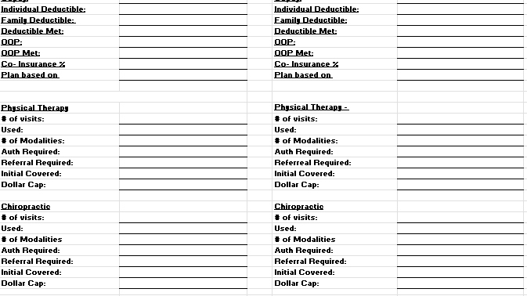
2. INACCURATE VERIFICATION OF BENEFITS
Failure to check patient benefits by calling and speaking with a representative is setting the provider up for failure. Implementing policies to ensure accurate benefit verifications can reduce denials.

Slide 5
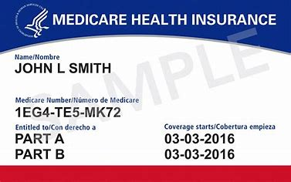
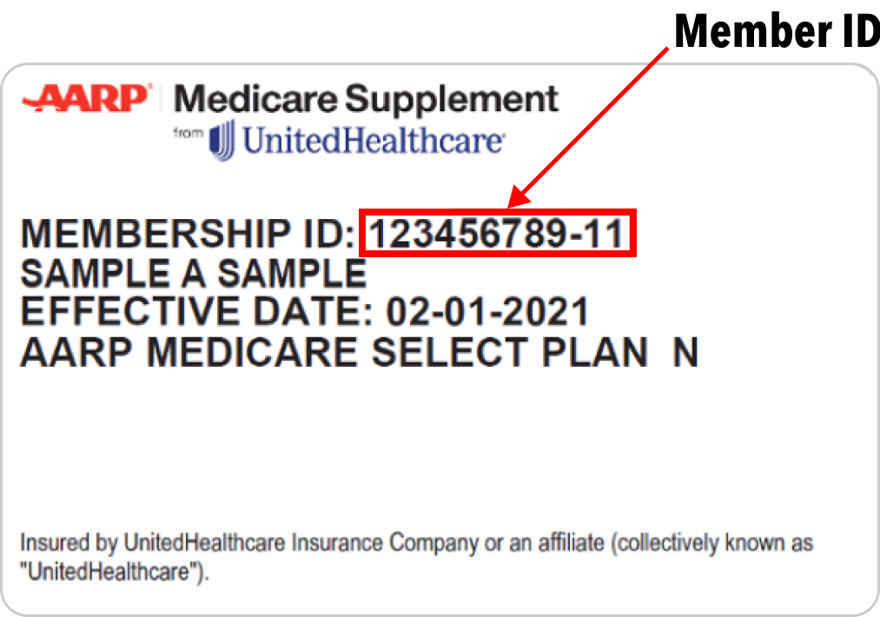
3. Understanding insurances
SECONDARY VS SUPPLEMENT
WHEN IT COMES TO HEALTH INSURANCE, THERE ARE KEY POINTS TO REMEMBER.
THE DIFFERENCE BETWEEN SECONDARY AND SUPPLEMENTAL COVERAGE
PRIMARY INSURANCE – A PATIENT CANNOT HAVE TWO MEDICARE PLANS SIMUTANEOUSLY. IF A PATIENT PRESENTS A MEDICARE ID AND A MEDICARE ADVANTAGE ID (AETNA MEDICARE) , THE MEDICARE ADVANTAGE PLAN IS THE PRIMARY INSURANCE
SECONDARY INSURANCE – THESE PLANS WORK ALONGSIDE YOUR PRIMARY PLAN TO COVER GAPS IN COST, SERVICES NOT COVERED BY YOUR PRIMARY, OR BOTH. THESE PLANS ARE CONSIDERED BACK UP TO YOUR PRIMARY PLAN
(HORIZON BCBSNJ DIRECT ACCESS/NJ DIRECT/AETNA, UHC, CIGNA)
SUPPLEMENTAL INSURANCE – THESE PLANS COVER ONLY A PERCENTAGE OF YOUR MEDICARE PLAN. THESE PLANS DO NOT OFFER THE SAME BENEFITS AS A SECONDARY PLAN. MOST SUPPLEMENTAL INSURANCES WILL COVER THE PRIMARY DEDUCTIBLE, CO-INSURANCE, CO PAY UP TO 20% OF MEDICARE.

Slide 6




4. LACK OF OBTAINING AUTHORIZATION
THIS ALL STARTS WITH THE ACCURACY OF YOUR VERIFICATIONS.
KNOWING WHICH CODES AND SPECIALTIES REQUIRE AUTHORIZATION UNDER EACH INSURANCE CAN REDUCE DENIALS.

Slide 7
5. DOCUMENTATION
MAKING IT MANDATORY FOR NEW AND SEASONED PROVIDERS TO COMPLETE SOAP NOTES IN A TIMELY MANNER
ENSURING THAT THE DOCUMENTATION HAS ALL VIABLE INFORMATION THAT EXPLAINS TREATMENT FOR THE PATIENT.
FRIENDLY REMINDER ☺
Insurance companies can ask for documentation at any given point regardless of the benefit details.

Slide 8
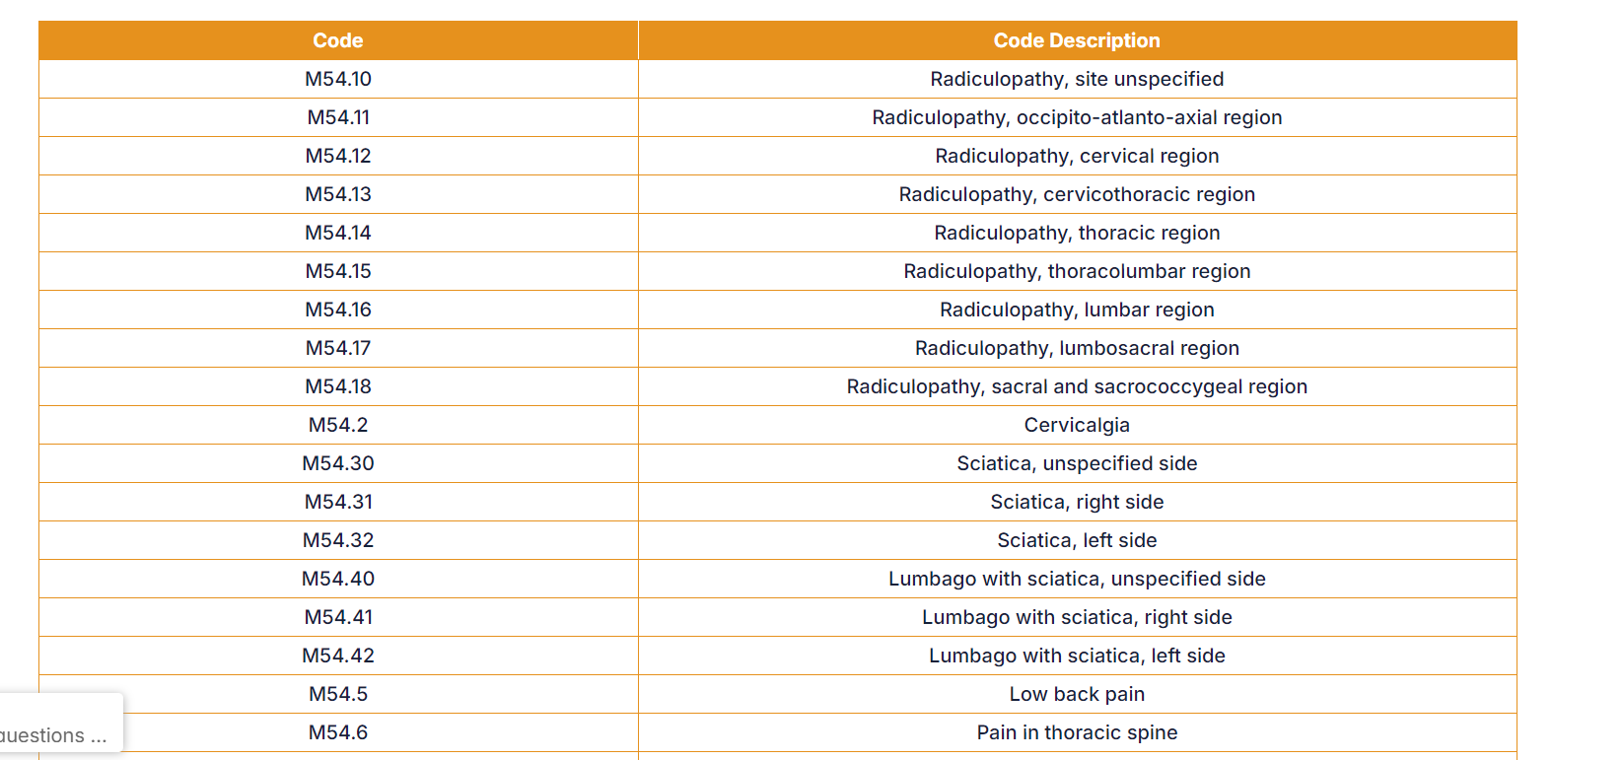
6. MISUSE OR INACCURATE DX CODES
Using inaccurate DX codes or deleted diagnosis codes are negligent on the office.
To decrease the misuse of inaccuracy of correct diagnosis codes cause denials, documentation request, and audits.
  NEWEST ICD-10 DELETION AS OF OCTOBER 2024 – M51.36 AND M51.37
  M54 CODES WITH THE M51 CODES ON THE SAME CLAIM ARE CONSIDERED EXCLUSIVE TO ONE ANOTHER AND THE CLAIM WILL BE DENIED

Slide 9
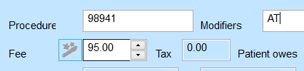

7. USE OF INCORRECT MODIFIERS
MOST COMMON ERROR……
  1: MISUSE OF MODIFIERS
  2: NOT USING MODIFERS FOR PROCEDURE CODES WHEN NEEDED
MEDICARE: CHIRO MODIFIER
MEDICARE: PT MODIFIER
**USE OF INCORRECT MODIFIERS CAN LEAD TO DELAY IN PAYMENTS, MEDICAL RECORDS REVIEW, AUDITS, AND DENIALS**

Slide 10
8. UP CODING
Definition: Using higher level CPT code than justified to maximize reimbursement.
“Upcoding” occurs when a service is performed and a diagnosis or a procedure is submitted to the insurance company with codes or diagnoses more serious than what was evaluated.
Example: submitting radiculopathy or disc degeneration to the insurance company when the patient has low back pain.

Slide 11

9. DUPLICATE BILLING
A duplicate denial indicates more than one claim was submitted for the same service, for the same patient, or for the same date of service.
EXAMPLES OF DUPLICATE BILLING:
The practice submits a revised claim that does not contain the correct information.
The clinic bills a patient more than once for a single service.
The clinics performs the same service multiple times in one day.
Another medical practice gives a patient the same service as your clinic on the same day and then submits an identical CPT code.

Slide 12

10. CORRECTED CLAIMS
IT IS VERY IMPORTANT TO UNDERSTAND THAT CORRECTED CLAIMS CANNOT BE PERFORMED FOR THE BENEFIT OF MAXIMIZING REIMBURSEMENT.
MAKE SURE WHEN SENDING A CORRECTED CLAIM, YOU STAMP THE TOP OF THE HCPCA WITH “CORRECTED CLAIM” AND THEN EXPLAIN IN BOX 19 WHAT IS BEING CORRECTED TO ELIMINATE DUPLICATE BILLING.
EXAMPLES OF WHY YOU WOULD SUBMIT A CORRECTED CLAIM:
TO FIX A MODIFIER/ADD A MODIFIER
CORRECT OR POINT TO A CERTAIN DX CODE THAT EXPLAINS WHY THE SERVICE WAS PERFORMED.

Slide 13
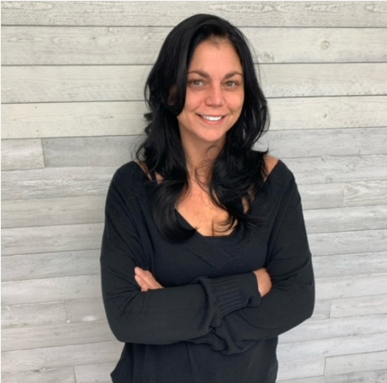
FOCUSED
BILLING AND COLLECTIONS
Stephanie Schaffer, Owner/Founder
57 Schanck Road
Building C, Suite 9-10
Freehold, NJ 07728
T: 732-982-3602
F: 732-782-8182
E: SSCHAFFER@FOCUSEDBILLING.COM
WEBSITE: FOCUSEDBILLING.COM
“Physician, Profit, Success”
“A clean claim is a paid claim”

